Slide 1

MINI - Project Presentation
Topic - “ I-Chat : An online Web chat application”
Submitted By :-
Umang Chauhan
Shubham Bhardwaj
Tanmay Gaur
Shubhransh Singh
Haresh Singh
Department of Computer Engineering and Applications
Institute of Engineering and Technology
GLA University
Mathura-281406, India

Slide 2

PROBLEM STATEMENT
What are WE creating
Communicating virtually with people is when individuals interact without being face-to-face but through words and texts that are sent at a higher speed than letters. We can share information, comment, and ask questions, develop social etiquette.
Communicating virtually make us elevate from being digitally literate to digitally fluent, collaborate using appropriate virtual tools and system and they are cost-effective too.
So putting our efforts into this application, we are creating I-chat an online web - chat application.

Slide 3

What is the Idea ?
This real-time chat web-browser is been developed for web-technologies on various devices like iPad, mobile phones, desktop, laptops, etc. by many users. Multiple users can interact at the same time on this web-page and can chit-chat there.
Front-end is a practice of converting data to a graphical interface, through the use of HTML, CSS, and JavaScript, so the users can view and interact with that data and,
Back-end development refers to server-side development. It focuses on databases, scripting, and architecture of websites
Code written by back-end developers helps to communicate the database information to the browser displaying the front-end.

Slide 4

Motivation Behind …
In today’s era, we all are aware of the need to communicate with each other.
However we the people are so busy in our own lives, we forget and sometimes ignore that the world beyond us exists.
One solution to this problem can be the Virtual Communication and is the most efficient and commonly used medium these days .
This is connecting millions and making it possible to interact with them no matter at what distance in real life but virtually at a distance of just a network connection.
Thanks to the Internet for coming up with ideology and the technology to make is possible.
So putting our efforts into this application, we have created “Grossify”.

Slide 5






Technologies Used
For the completion of the task the following Techs have been used:
Visual Studio Code Editor
HTML
CSS
JavaScript
Git & Git-hub
NodeJS
SocketIO

Slide 6

VS Code Editor
Visual Studio Code is a free source-code editor made by Microsoft for Windows, Linux and macOS. Features include support for debugging, syntax highlighting, intelligent code completion, snippets, code refactoring, and embedded Git.
Microsoft has released Visual Studio Code's source code on the VSCode repository of GitHub.com, under the permissive MIT License, while the compiled binaries are freeware.

Slide 7
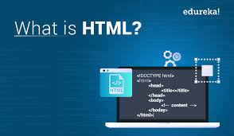
HTML
HTML stands for Hypertext Markup Language, and
it is the most widely used language to write Web Pages.
Hypertext refers to the way in which HTML documents are linked together.
Thus, the link available on a webpage is called Hypertext.
HTML is being widely used to format web pages with the help of different tags available in HTML language.
HTML is the language for publishing web pages on the WWW (World-Wide Web).
HTML is a Document Description Language (aka Document Markup Language).

Slide 8
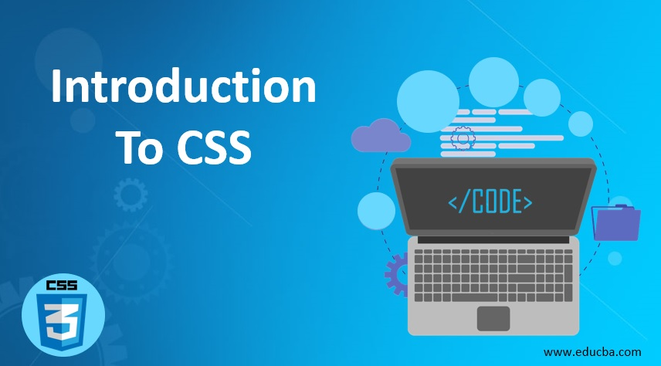
CSS
CSS is acronym for Cascading Style Sheets and is a markup language
responsible for how your web pages will look like. It controls the colors, fonts, and layouts of your website elements.
It is a style sheet language used for describing the presentation of a document written in a markup language like HTML. CSS is designed to enable the separation of presentation and content, including layout, colors, and fonts. A style rule is made of three parts :−
Selector − A selector is an HTML tag at which a style will be applied.
Property − A property is a type of attribute of HTML tag.
Value − Values are assigned to properties. For example, color

Slide 9
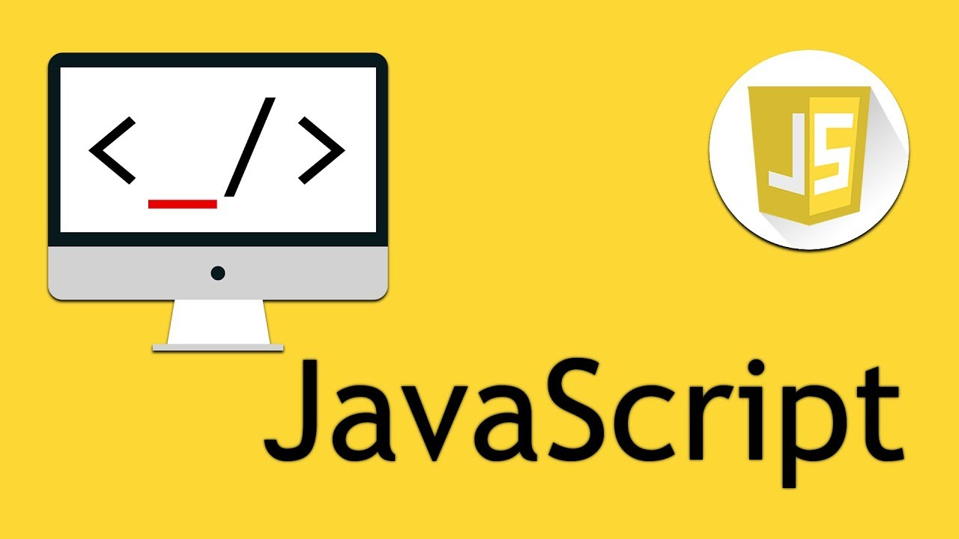
JavaScript
JavaScript is a client-side scripting language and used to build interactive websites with dynamic features and to validate form data.
JavaScript is high-level, dynamic and browser interpreted programming language, supported by all modern web browsers.
JavaScript is also used to build scalable web applications using Node JS. JavaScript is also being used widely in game development and Mobile application development.
JavaScript is also known as the Programming Language of web as it is the only programming language for Web browsers. JavaScript is an object-based scripting language which is lightweight and cross-platform.

Slide 10


Git & Git-hub
Git is a distributed version-control system for tracking changes in any set of files, originally designed for coordinating work among programmers cooperating on source code during software development. Git was created by Linus Torvalds in 2005 for development of the Linux kernel.
GitHub, Inc. is a subsidiary of Microsoft which provides hosting for software development and version control using Git.
It provides access control and several collaboration features such as bug tracking, feature requests, task management, continuous integration and wikis for every project.

Slide 11
Node JS
Node.js is an open-source, cross-platform, back-end, JavaScript runtime environment that executes JavaScript code outside a web browser. Node.js lets developers use JavaScript to write command line tools and for server-side scripting - running scripts server-side to produce dynamic web page content before the page is sent to the user's web browser. Consequently, Node.js represents a "JavaScript everywhere" paradigm, unifying web-application development around a single programming language, rather than different languages for server- and client-side scripts.
The Node.js distributed development project was previously governed by the Node.js Foundation, and has now merged with the JS Foundation to form the Open JS Foundation, which is facilitated by the Linux Foundation's Collaborative Projects program.

Slide 12
Socket.IO
Socket.IO is a JavaScript library for real-time web applications. It enables real-time, bi-directional communication between web clients and servers. It has two parts: a client-side library that runs in the browser, and a server-side library for Node.js. Both components have a nearly identical API. Like Node.js, it is event-driven.
Socket.IO primarily uses the Web Socket protocol with polling as a fallback option while providing the same interface. Although it can be used as simply a wrapper for Web Socket, it provides many more features, including broadcasting to multiple sockets, storing data associated with each client, and asynchronous I/O.

Slide 13

User Interface (UI)

Slide 14
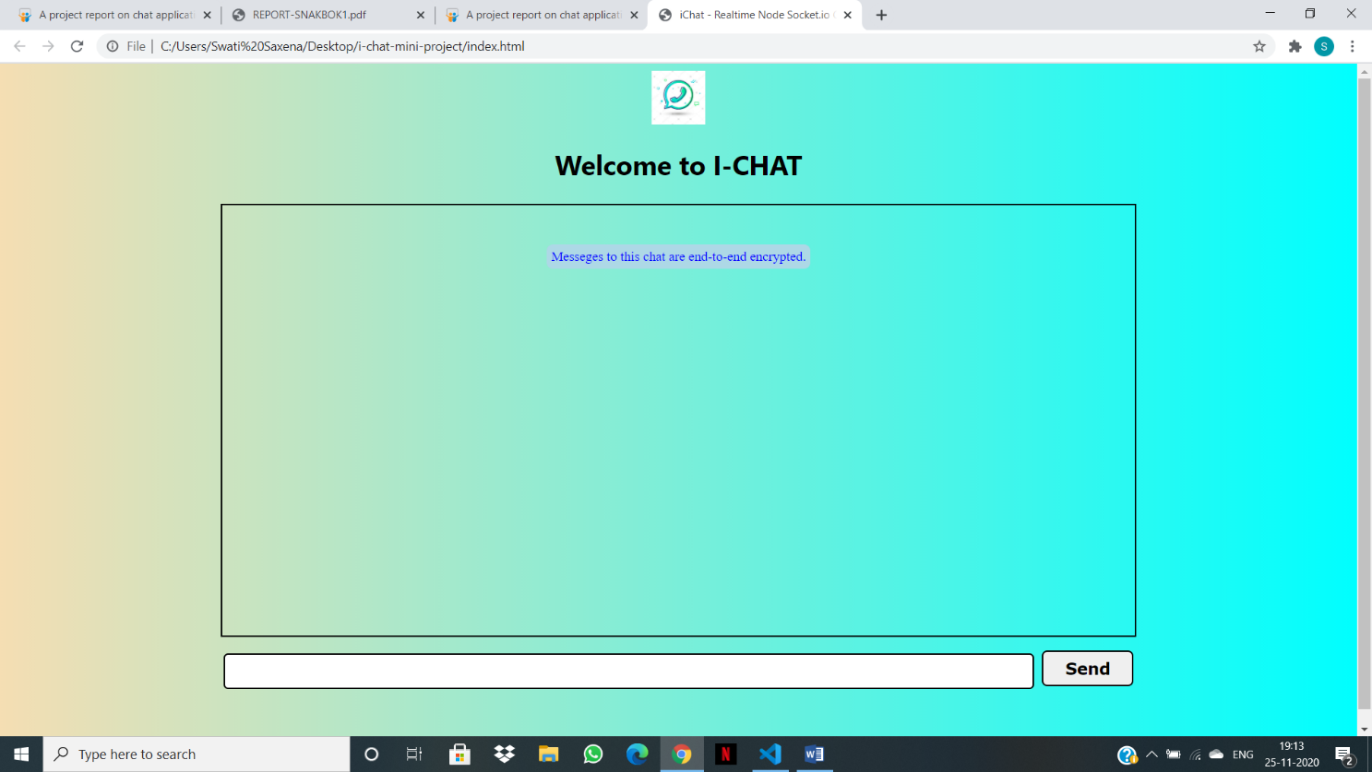
This is the First View of our I-Chat web application
Also the Front-end part.
<!DOCTYPE html>
<html lang="en">
<head>
<meta charset="UTF-8">
<meta name="viewport" content="width=device-width, initial-scale=1.0">
<title>iChat - Realtime Node Socket.io Chat App</title>
<script defer src="http://localhost:4000/socket.io/socket.io.js"></script>
<script defer src="js/client.js"></script>
<link rel="stylesheet" href="css/style.css">
</head>
<body>
<nav>
<img class="logo" src="chat.png" alt="">
<h1>Welcome to I-CHAT</h1>
</nav>
<div class="container">
<div id="block">
<p id="encryp"> Messeges to this chat are end-to-end encrypted.</p>
</div>
</div>
<div class="send">
<form action="#" id="send-container">
<input type="text" name="messageInp" id="messageInp">
<button class="btn" type="submit">Send</button>
</form>
</div>
</body>
</html>

Slide 15
This is the icon used for our I-chat app

Slide 16
Header demonstrating the CSS used in this.

Slide 17
Used Flex box to put all the elements in a container vertical view.

Slide 18
The form submit button to send the typed message.
The form input area to type the message here

Slide 19


Slide 20
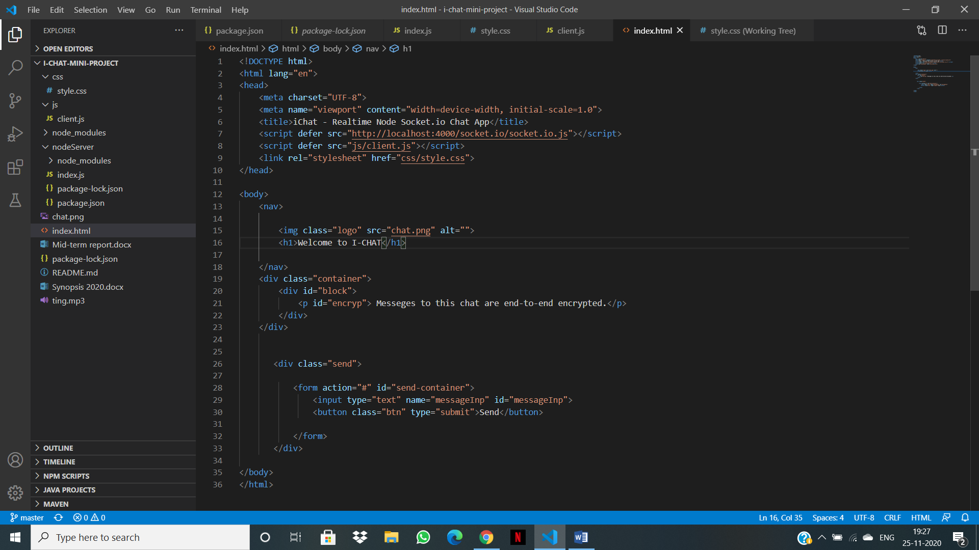
Step-1
Start the Project and Run commands to open node server in VS code editor’s terminal .

Slide 21
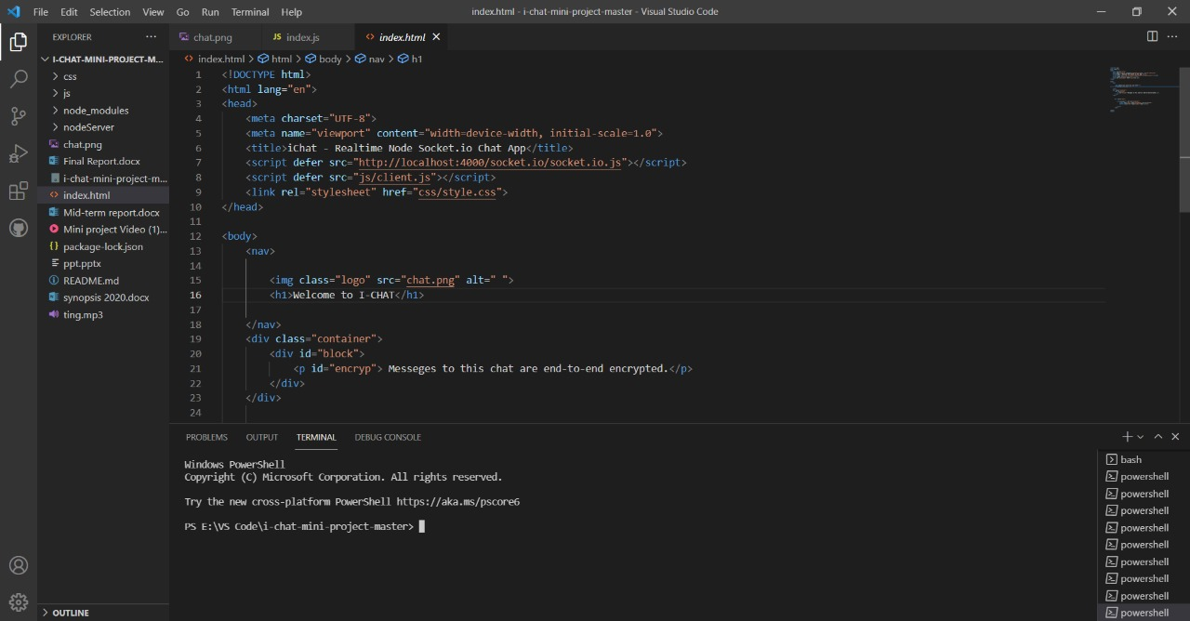

Slide 22
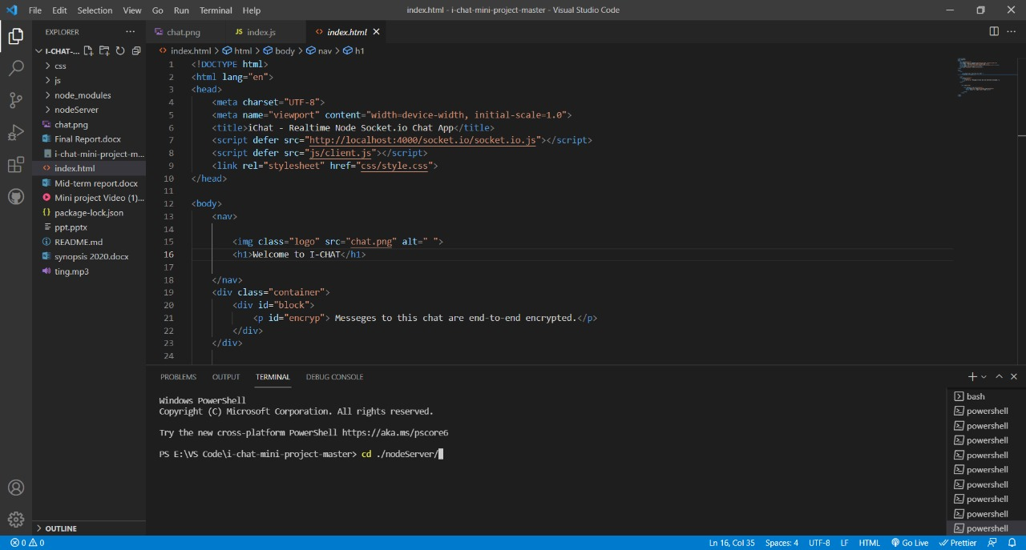

Slide 23
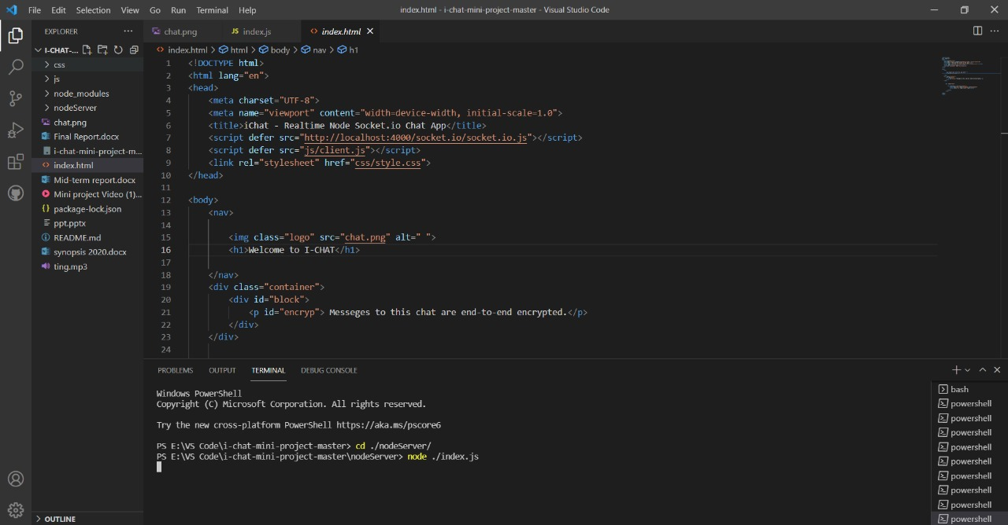

Slide 24
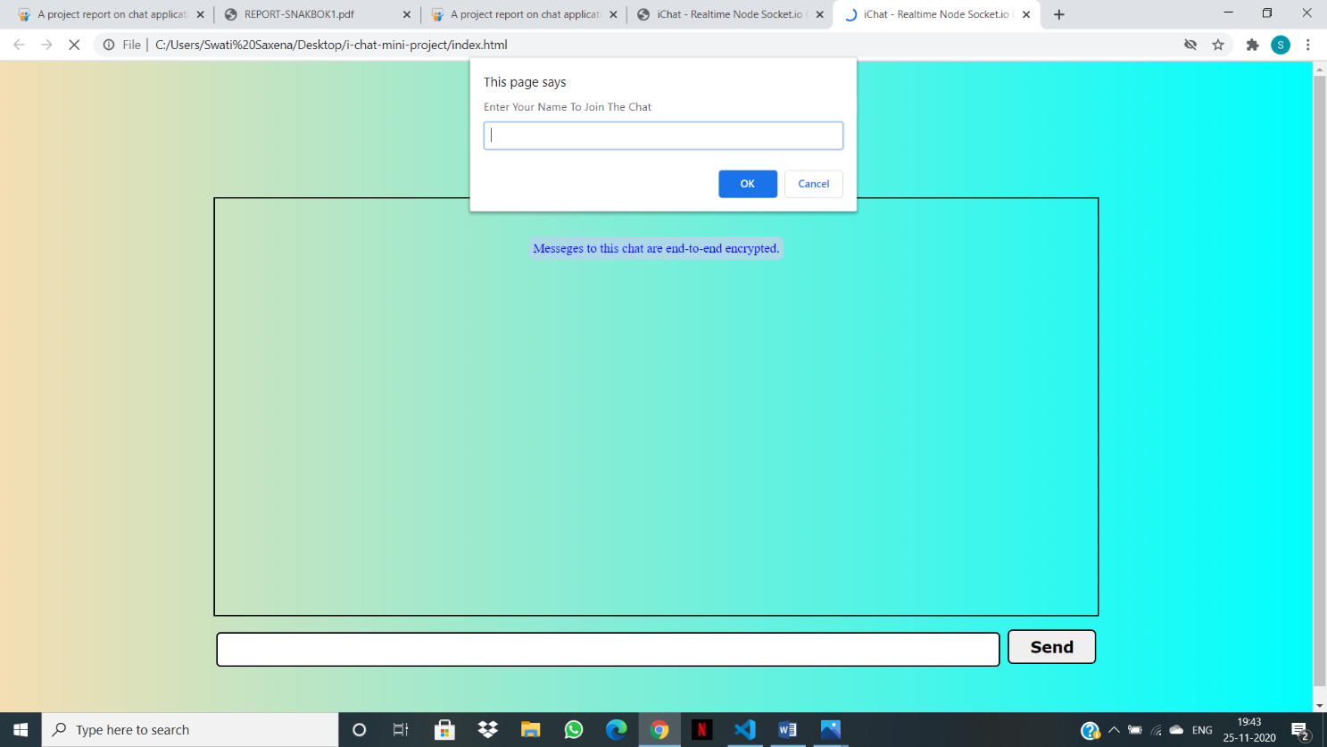
Step 2
Server will Start and Open the Project in Web Browser

Slide 25
Firstly the prompt will appear to ask NAME of the user

Slide 26
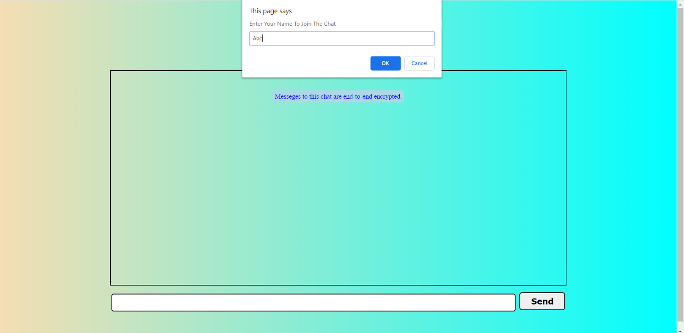
Here user will enter the name to join the chat.

Slide 27
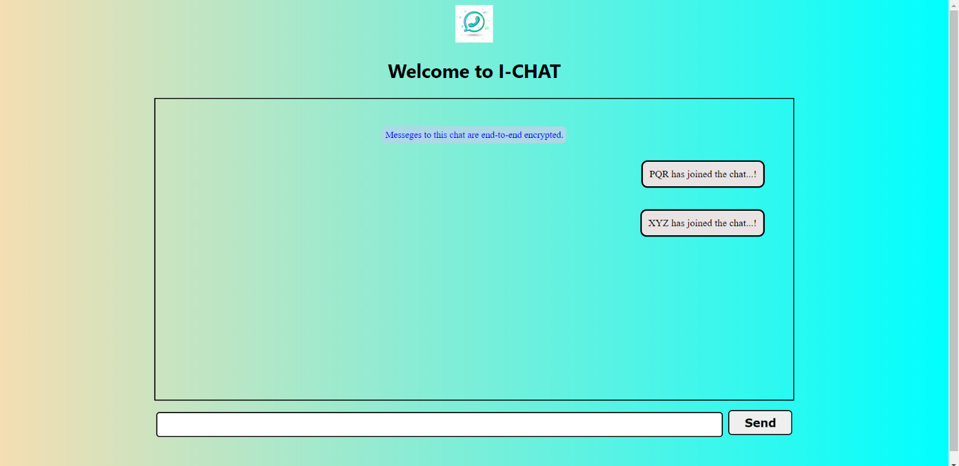
Then the notification to the users apart from the user joined will be send with the help of socket.io.
Notification be like XYZ has joined the chat…!.

Slide 28
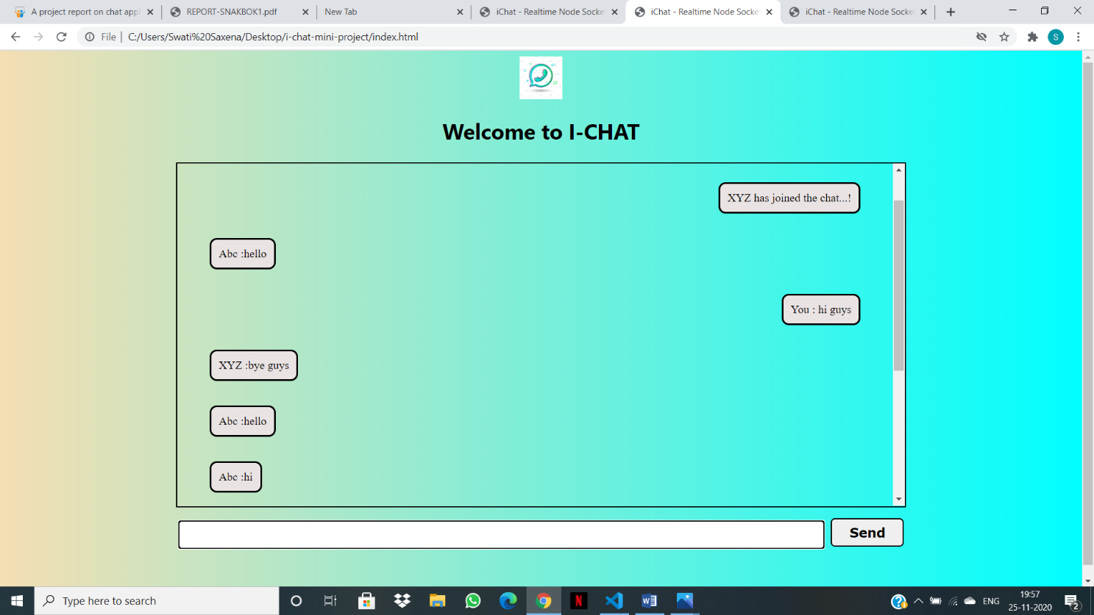
Then any user types the message then it would reflect to another windows too

Slide 29
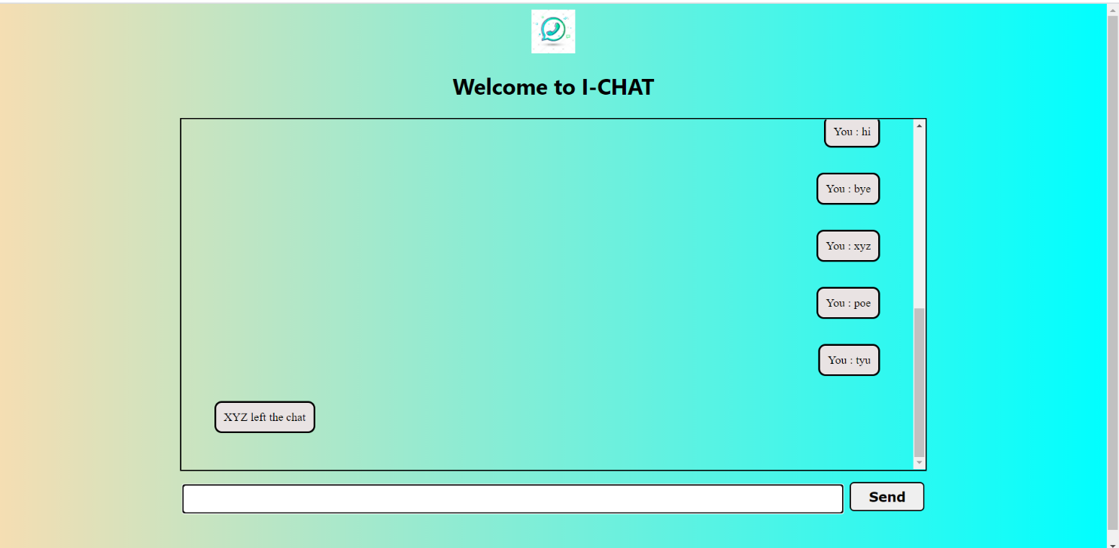
By chance any user left the chat then it would notify another user’s present in the chat that so & so left the chat with notification sound.

Slide 30
LINK FOR THE CODE :
https://github.com/ShubhamBhardwaj001/I-Chat.git
Thank You…!

